Slide 1
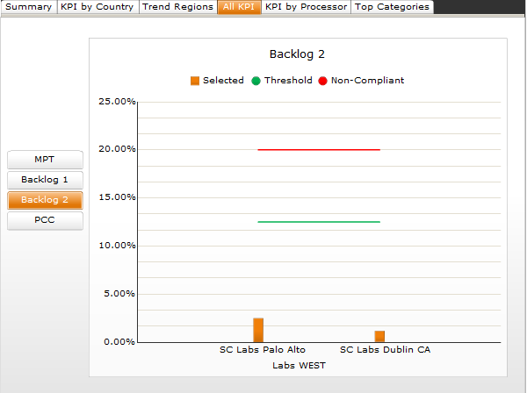
Notes:
IMPORTANT INFORMATION ABOUT THE VISUALIZATION EMBEDDED IN THIS SLIDE - IF YOU ARE EXPERIENCING DIFFICULTIES,PLEASE READ ON!
This PowerPoint slide includes a Flash visualization exported from Dashboard Design:
1). If you receive the following information message when you open the slide deck, you need to upgrade your version of Adobe.
"Some controls on this presentation cannot be activated. They might not be registered on this computer".
To upgrade Adobe Flash Player on your machine:
a). Close PowerPoint - DO NOT SAVE this slide deck.
b). Using Internet Explorer, install the latest Adobe Flash Player from www.adobe.com
c). Reopen this PowerPoint slide deck.
2). If the design-time thumbnail for the model is not visible, enter and exit Slide Show mode.
3) If you have Microsoft Office 2007, DO NOT save Word documents or PowerPoint presentations that contain Dashboard Design and Presentation Design models as Word Document or PowerPoint Presentation formats. Office 2007 files (pptx and docx formats) do not support embedded Flash files. Save documents and presentation files only as Word 97-2003 Document or PowerPoint 97-2003 Presentation formats.
4). If the visualization shows error code messages (#2048, etc), Flash security restrictions have prevented the embedded content from accessing external data. For more information about allowing visualizations to access external data, see the Adobe Flash Player Security Restrictions section in the Dashboard Design and Presentation Design User Guide.

